Slide 1
Understanding Heuristic Algorithms
Balancing Speed, Practicality, and Optimality in Computer Science

Slide 2
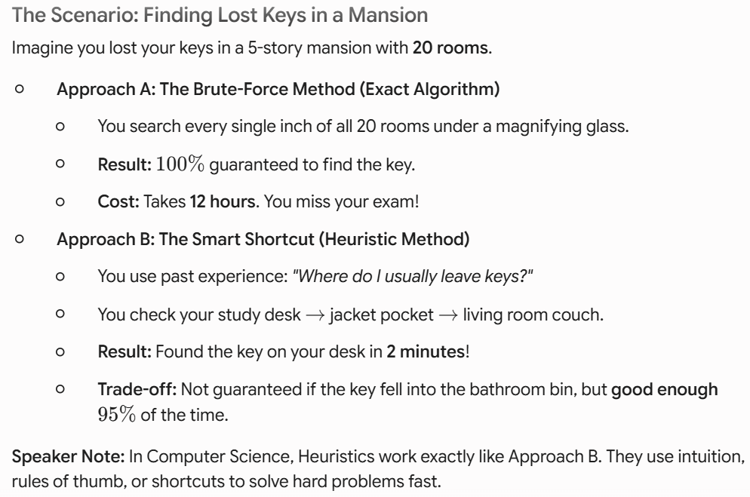
The Hook – An Everyday Story

Slide 3
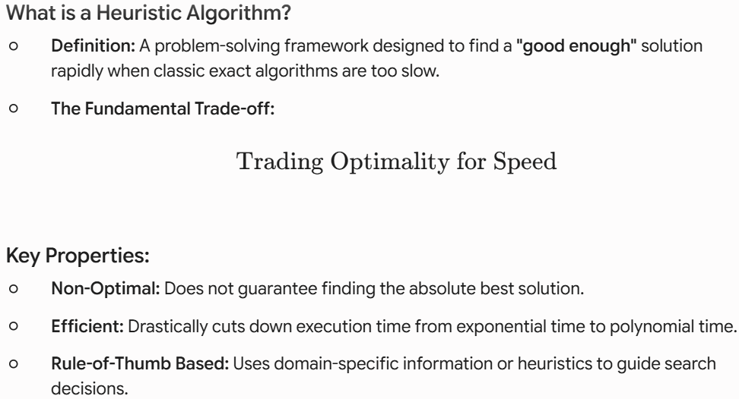
Formal Definition & Core Concept

Slide 4
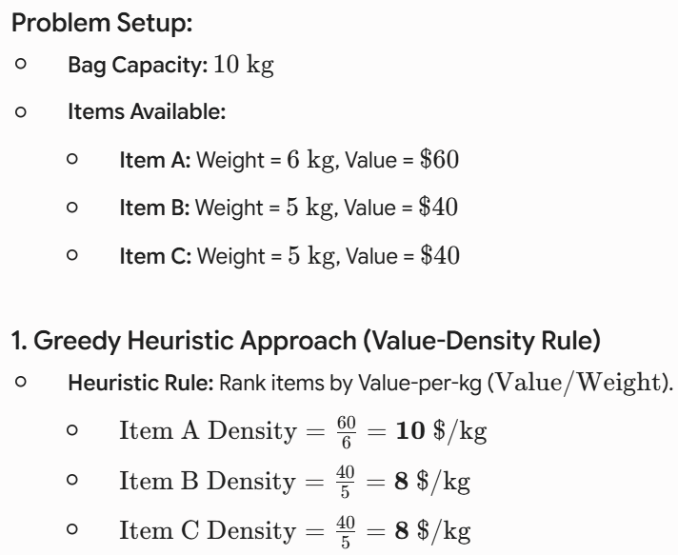
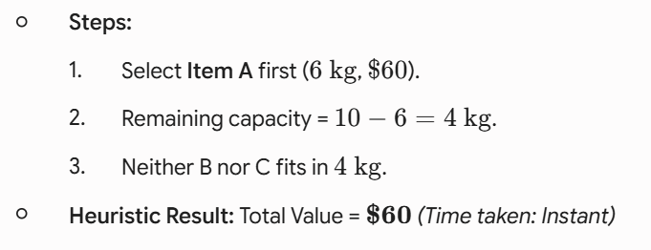
Mathematical Example – The Knapsack Problem

Slide 5
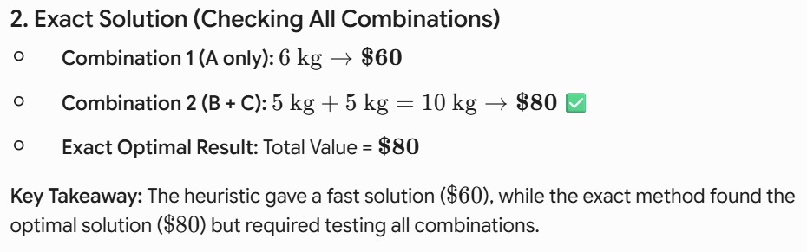
Mathematical Example – The Knapsack Problem

Slide 6
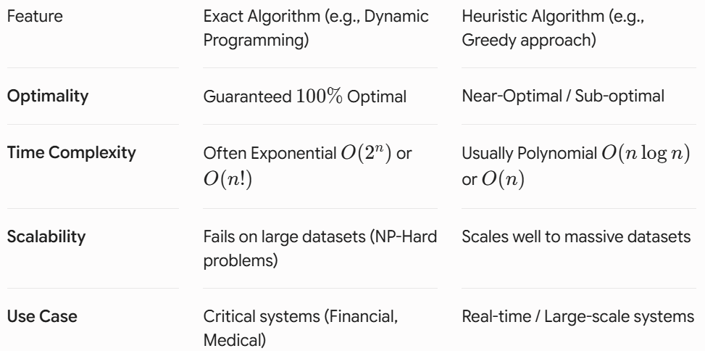
Heuristic vs. Exact Algorithms

Slide 7
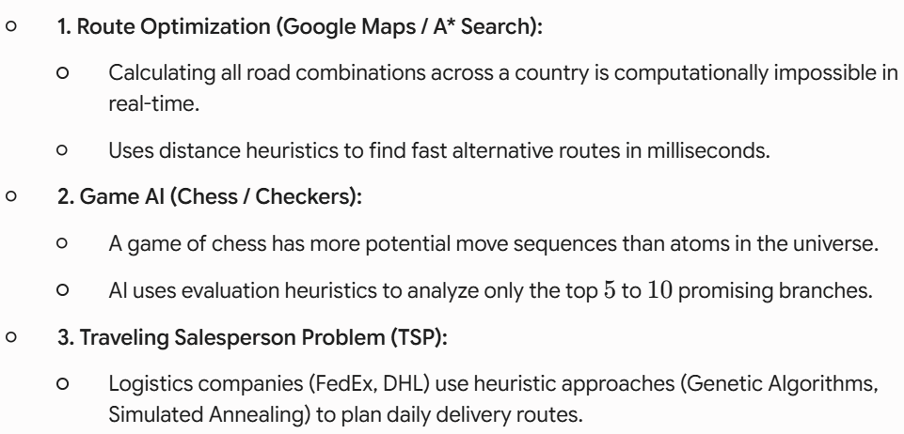
Real-World Applications

Slide 8
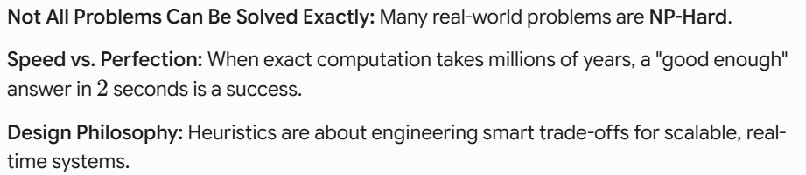
Summary & Takeaways
"Fast and good enough is usually better than perfect and infinite."

Slide 9
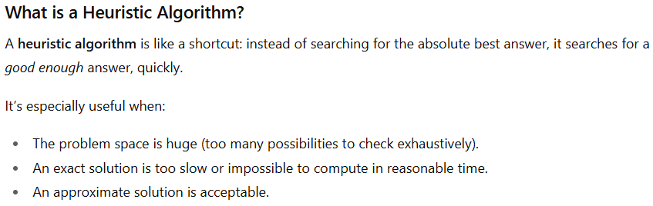
Heuristic Algorithm With Real Example

Slide 10
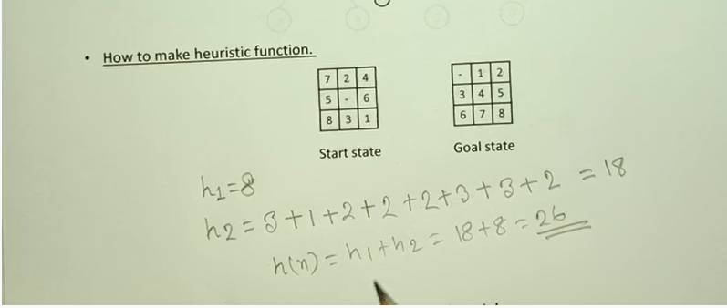
Heuristic function in artificial intelligence
This calculation measures how far the current board (Start state) is from the target board (Goal state) in an 8-Puzzle Game using a Heuristic Function (h(n)).

Slide 11
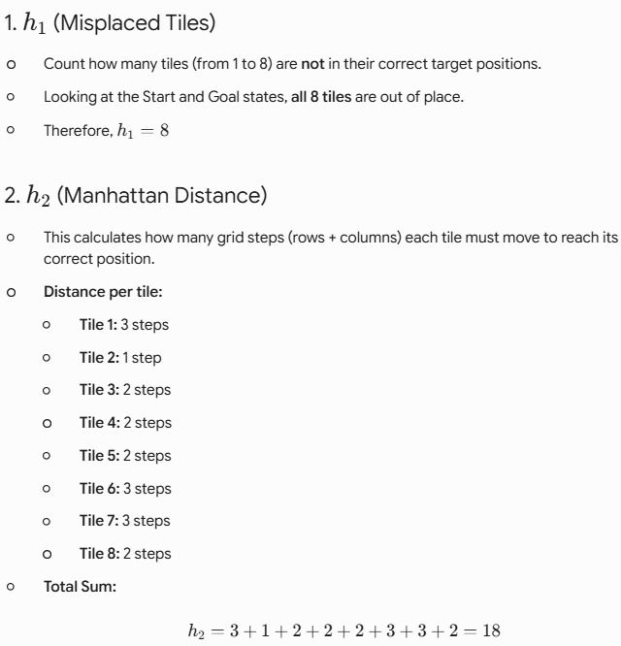
Heuristic function in artificial intelligence

Slide 12
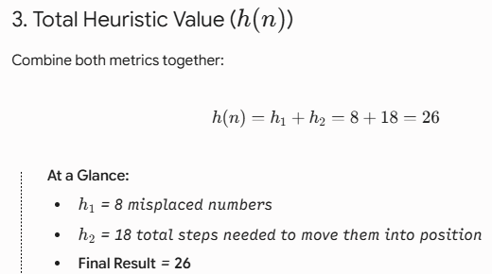
Heuristic function in artificial intelligence

Slide 13
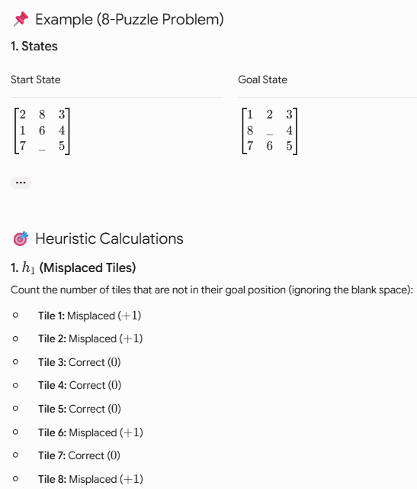

Slide 14
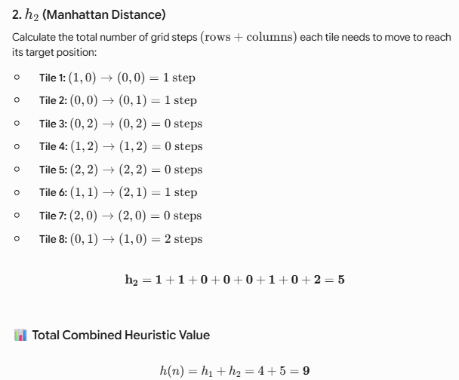

Slide 15
What is the difference between algorithm and a heuristic?
An algorithm is a step-wise procedure for solving a specific problem in a finite number of steps.
The result (output) of an algorithm is predictable and reproducible given the same parameters (input).
A heuristic is an educated guess which serves as a guide for subsequent explorations.

Slide 16
What is the difference between algorithm and a heuristic?

Slide 17
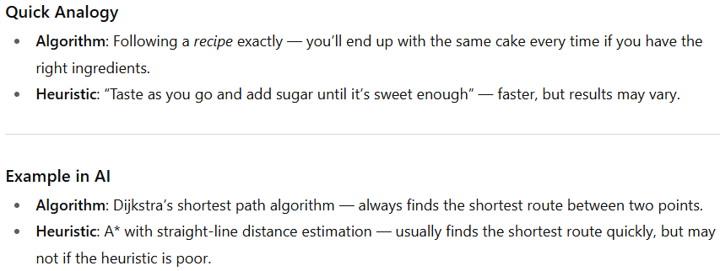
What is the difference between algorithm and a heuristic?

Slide 18
Are algorithms better than heuristics?
While algorithms provide step-by-step procedures that can guarantee solutions, heuristics are faster and provide shortcuts for getting to solutions, though this has the potential to cause errors.

Slide 19
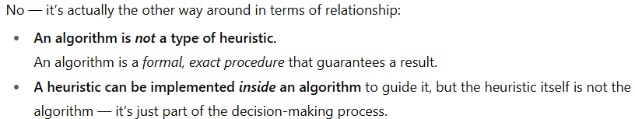
Is an algorithm a type of heuristic?

Slide 20
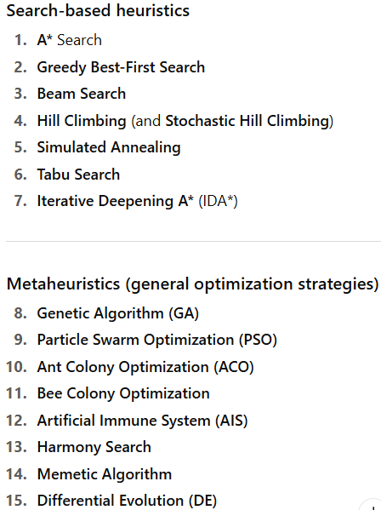
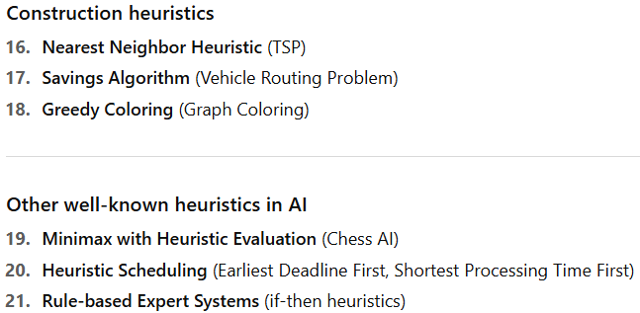
Well-known Heuristic Algorithms

Slide 21
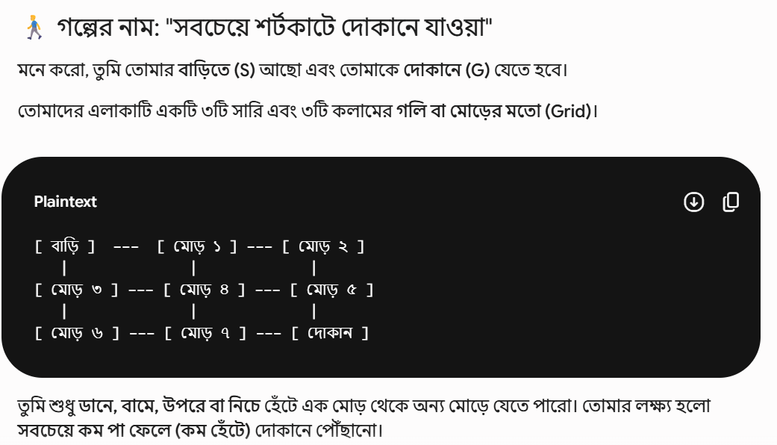
A* Search with example

Slide 22
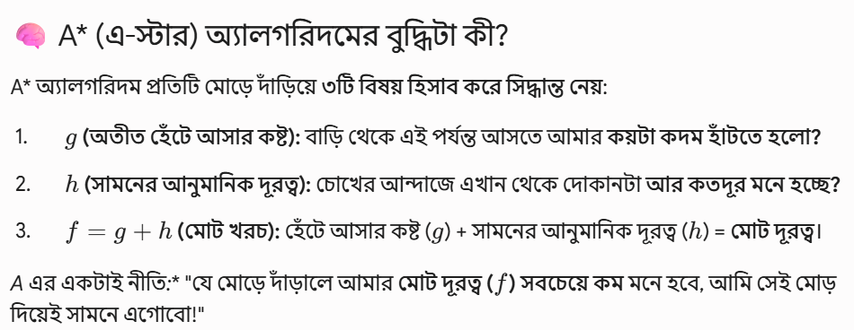
A* Search with example

Slide 23
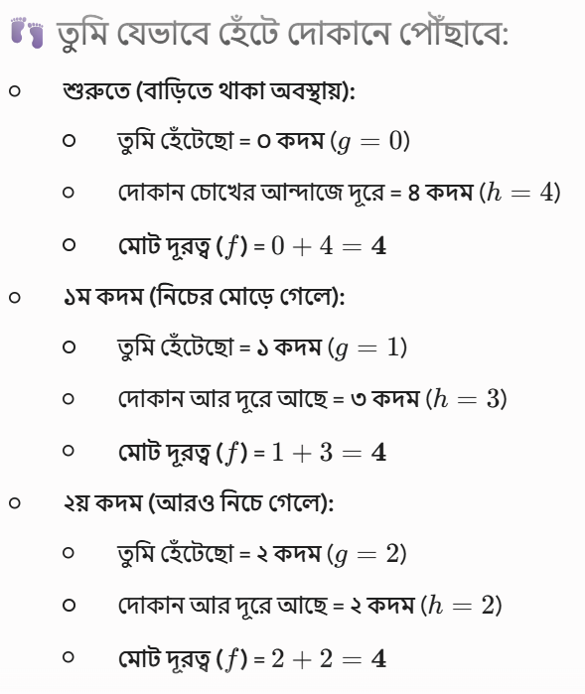
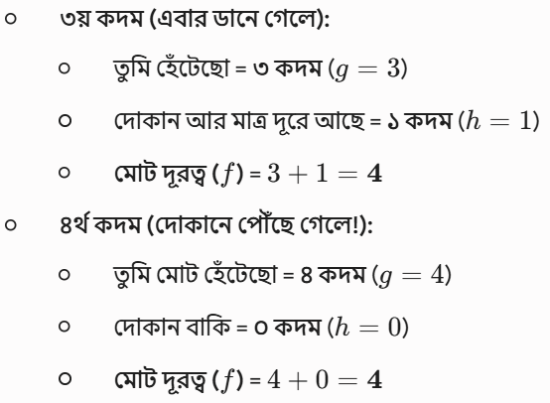
A* Search with example

Slide 24
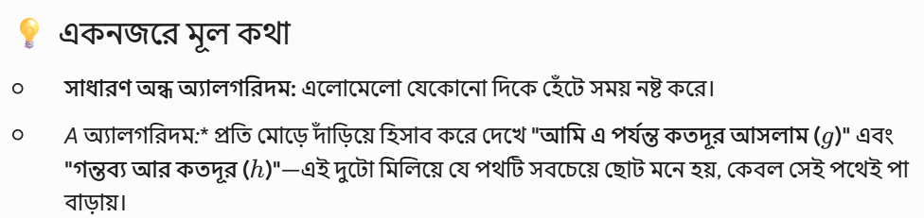
A* Search with example

Slide 25
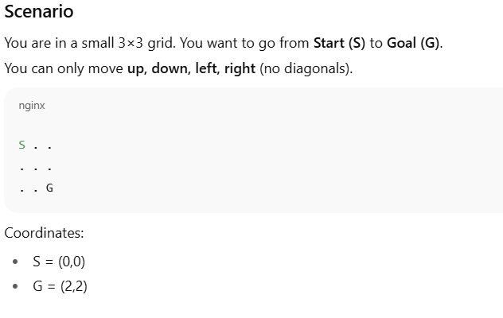
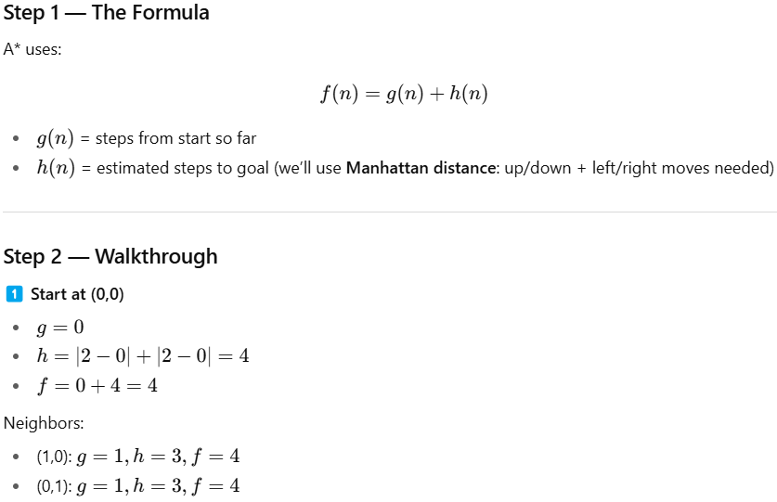
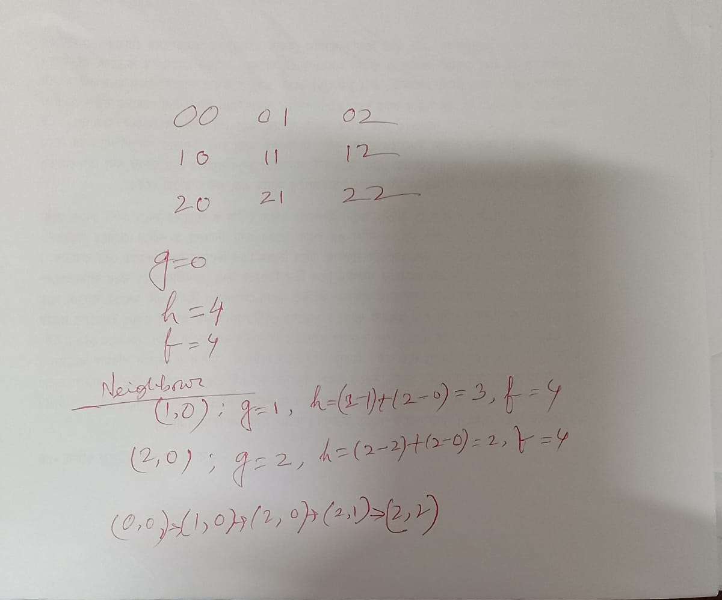
A* Search with example

Slide 26
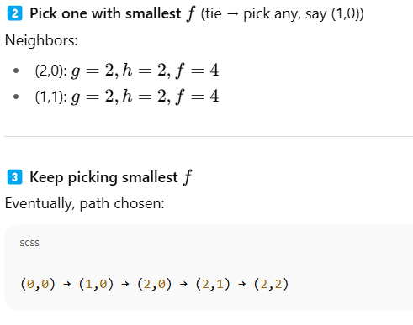
A* Search with example
Shortest path found in 4 moves, and we didn’t check every single cell blindly — the heuristic guided us toward the goal.

